Slide 1

COMP821 semester 1 2024
Session 5 Network Protection and Firewalls

Slide 2
Orientation
This lecture is an overview of Network protection against network attacks
-- Network access controls
-- Securing Ethernet networks
-- Securing wireless networks
-

Slide 3
Specific Network Vulnerabilities
Cryptography can be used to protect message confidentiality, authenticity, and integrity.
However: the means of delivering the messages could be stopped, slowed, or altered OR the route of the message could be altered OR Messages could be redirected to false recipients OR an attacker could gain access to communication channels that were previously considered closed and confidential
Therefore: The Goals of Creating Secure Networks
Availability-users have access to and network resources
Confidentiality-prevent unauthorized users from gaining information about the network
Functionality-preventing attackers from altering the capabilities or normal operation of the network
Access control -keep attackers or unauthorized employees from accessing internal information resources

Slide 4
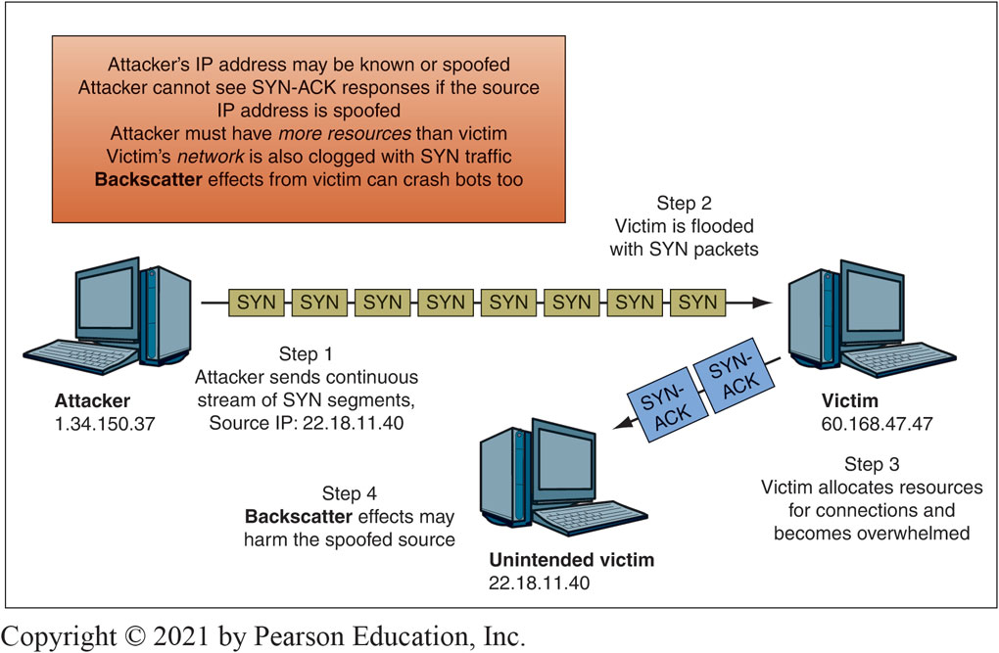
Denial of Service (DoS) Attack
A denial-of-service (DoS) attack : An attempt to make a server or network unavailable to legitimate users by flooding it with attack packets→ Leads to stopping critical services OR to slowly degrading services
Direct : victim flooded with a stream of packets directly from the attacker’s computer
Indirect: attacker’s IP address is spoofed (i.e., faked) , attack appears to come from another computer
Notes:
NOT a denial-of-service (DoS) attack: Faulty coding that causes a system to fail OR
Referrals from large websites that may overwhelm smaller websites
S Y N flood
(Background: the attack exploits a vulnerability of the TCO protocol): Attacker sends a T C P S Y N segment to a port
Application program sends back a S Y N/A C K segment and sets aside resources
Attacker never sends back an A C K, so victim keeps the resources reserved
Victim soon runs out of resources and crashes or can no longer serve legitimate traffic

Slide 5
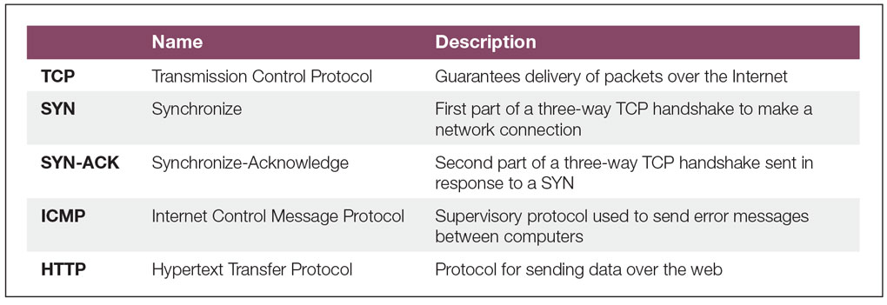
Common Types of Packets Used in DoS Attacks
Ping Flood A victim is flooded with ICMP (Internet Control Message Protocol) packets (also known as echo requests) that appear to be normal supervisory traffic. Bandwidth and CPU cycles are consumed to the point where the victim crashes.
DDoS attack – distributed denial of service attack
: intermediaries attack victims
--Botmaster controlled bots
--Updatable programs → Handler can update the software to change the type of attack the bot can do AND can update the bot to fix bugs
--In some attacks, legitimate traffic is used as an attack weapon
-- Sell or lease the botnet to other criminals!
HTTP Flood A victim, typically a webserver, is flooded with application layer web requests. The webserver crashes due to insufficient memory and CPU power.
Notes:
This table shows just a few of the types of packets that could be sent in a DoS attack.

Slide 6
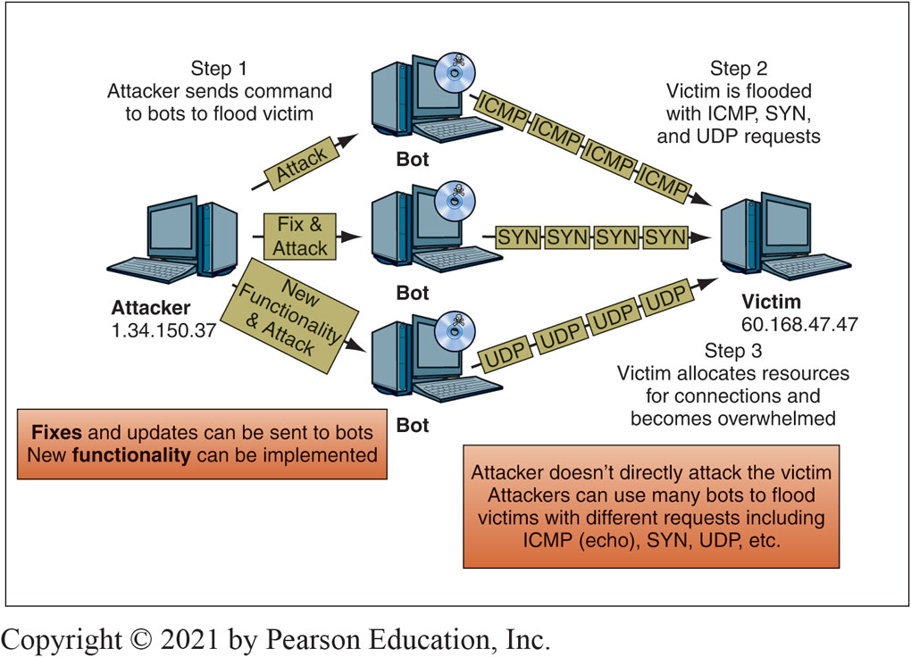
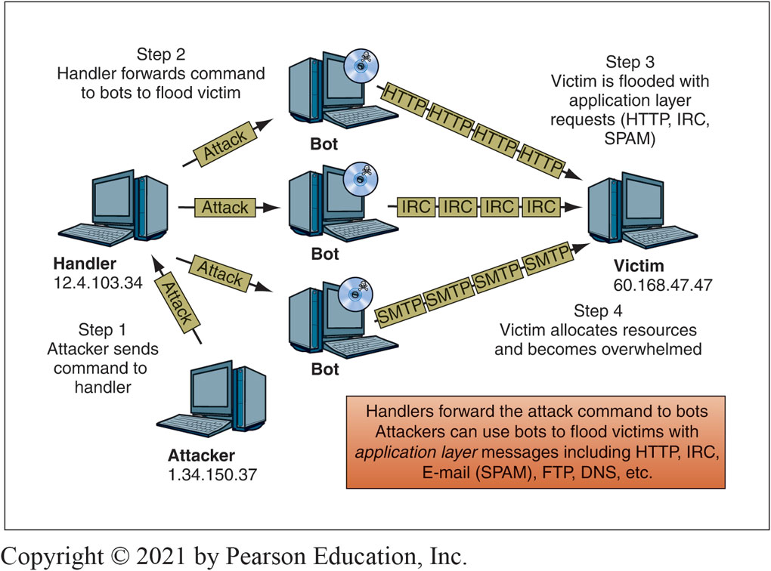
DDoS Attacks: (FIg.4.5) Fixing and Updating Bots; (Fig.4.6) using a handler
Notes:
the botmaster (attacker) is not limited to sending attack commands to installed bots. And yes, IRC – Internet relay Chat protocol, is still being used

Slide 7
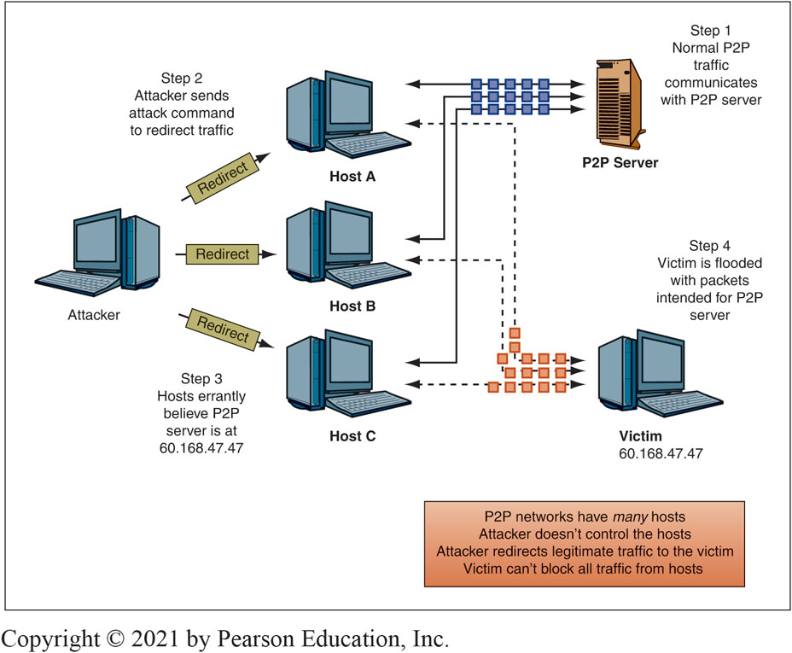
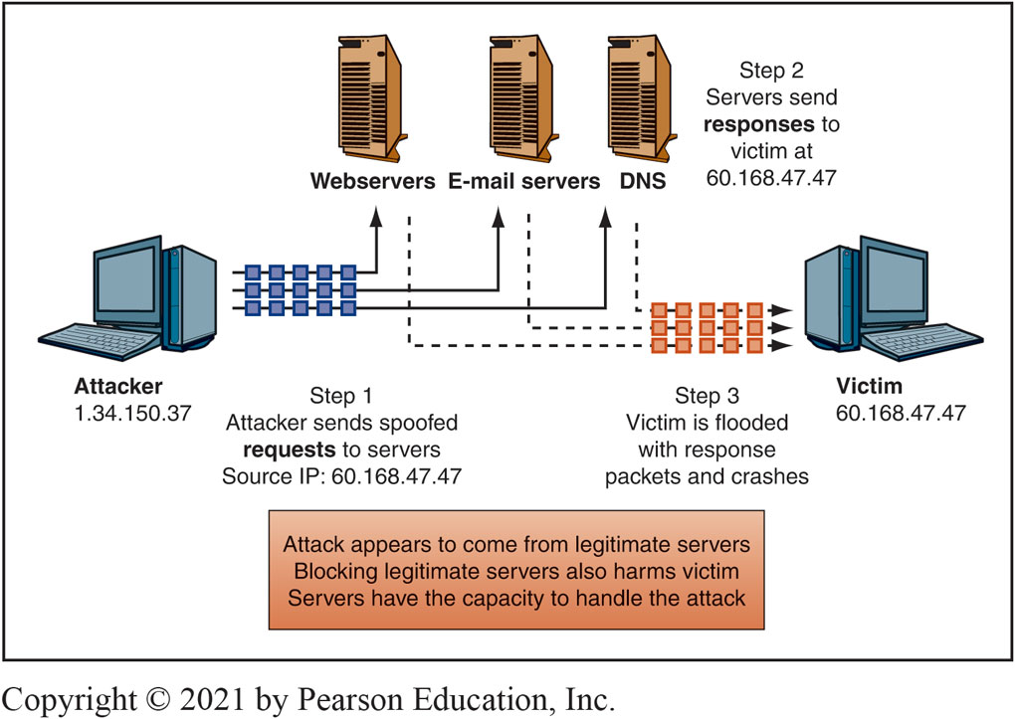
Fig 4.8 Distributed Reflected DoS (DRDoS) Attack
Fig. 4-73. PEER-to-peer redirect DoS attack

Slide 8
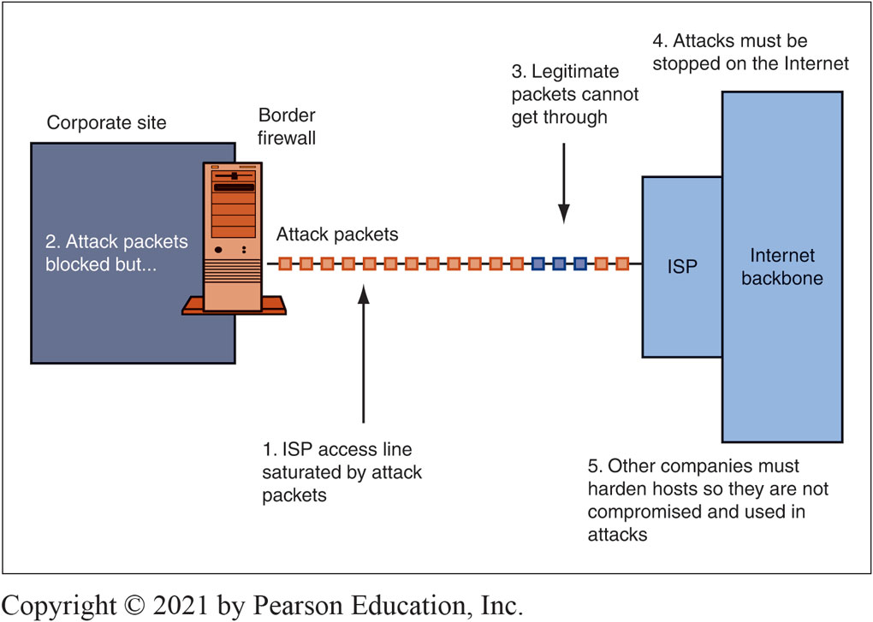
Protection?
Fig . 4.11
Three common ways of stopping the DoS attacks
Black holing
Validating the handshake
Rate limiting
Read about Smurf Flood attacks and sending malformed packet attacks in your eBook
Notes:
Black Holing : drop all IP packets from an attacker. ---but ---attackers can quickly change source IP addresses . Also, attacker may knowingly spoof attack packets with the IP addresses of a corporate partner → the legitimate partner will be blocked! . Validating the Handshake: when a SYN segment comes in, the firewall itself sends back a SYN/ACK segment, without passing the SYN segment on to the target server. When the firewall gets back the expected ACK, he firewall send the original SYN segment to the server for which it was intended. The firewall does not set aside resources for a connection when a SYN segment arrives, so handling a large number of false SYN segments is only a small burden.
Rate Limiting: rate limiting can be used to reduce a certain type of traffic to a reasonable amount. For example, the effects of a Smurf flood could be mitigated by limiting the number of ICMP packets entering a network. Broadcasting to the internal network could still be used, but at a limited rate. Rate limiting frustrates legitimate users, it is a temporary solution.

Slide 9
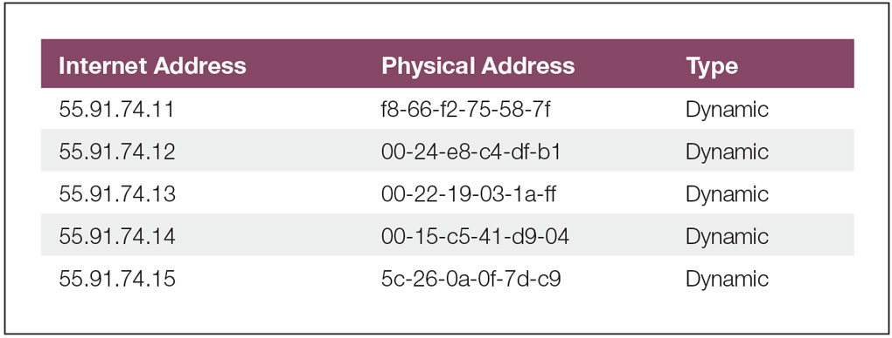
A R P Poisoning
Address Resolution Protocol (ARP)
--Used to resolve 32-bit IP addresses into 48-bit local MAC addresses
--Hosts on the same network must know each other’s MAC addresses before they can send and receive packets using IP addresses
--Hosts build ARP tables
The problem: A R P requests and replies do N O T require authentication or verification
==All hosts trust all A R P replies
==A R P spoofing uses false A R P replies to map any I P address to any M A C address
==An attacker can manipulate A R P tables on all L A N hosts
==The attacker must send a continuous stream of unsolicited A R P replies
A R P poisoning
Network attack that manipulates host A R P tables to reroute L A N traffic
Reroutes for a man-in-the-middle attack
Continuous stream of spoofed A R P replies
False A R P replies redirect traffic
Gateway and hosts are poisoned
Preventing ARP Poisoning
Static tables
Limit local access
Watch https://www.youtube.com/watch?v=A7nih6SANYs

Slide 10
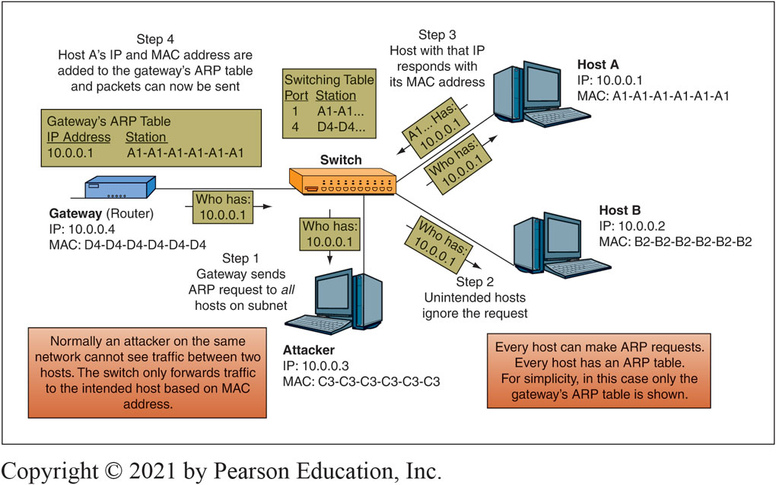
Fig. 4.14 Normal ARP Traffic
Notes:
Figure 4-14 shows how ARP would normally work on a LAN.

Slide 11
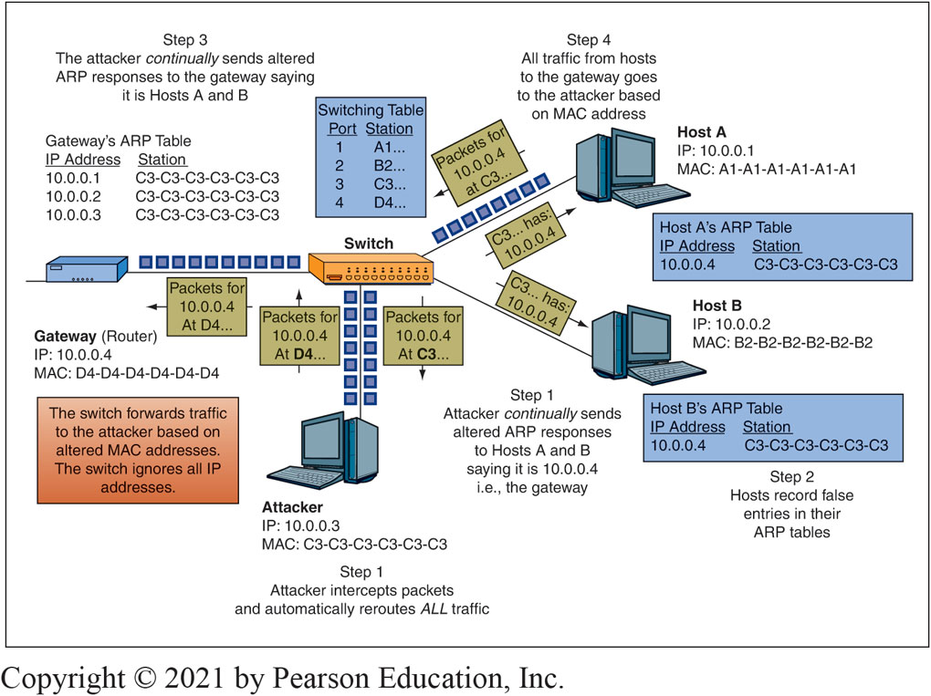
Fig. 4.15 ARP Poisoning
STEP 5 RESULT
Notes:
Figure 4-15 shows how ARP poisoning can be used to reroute traffic for a MITM attack.

Slide 12
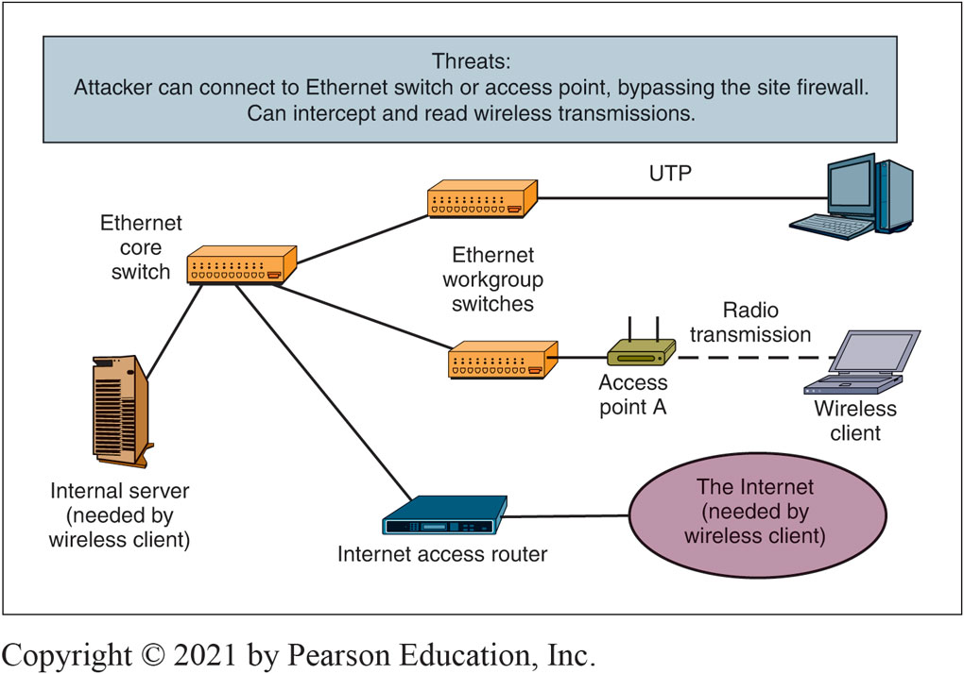
Access Control for Networks
Notes:
This figure illustrates a simplified LAN at a corporate site. Computers connect to the LAN through Ethernet switches. Some do so via 4-pair UTP cords connected to wall jacks.
For both wired LANs and wireless LANs, once intruders gain access, they can use a packet sniffer to intercept and read legitimate traffic. On Ethernet LANs, encryption is rare, but it is difficult to get physical access to Ethernet wires or wall jacks.

Slide 13
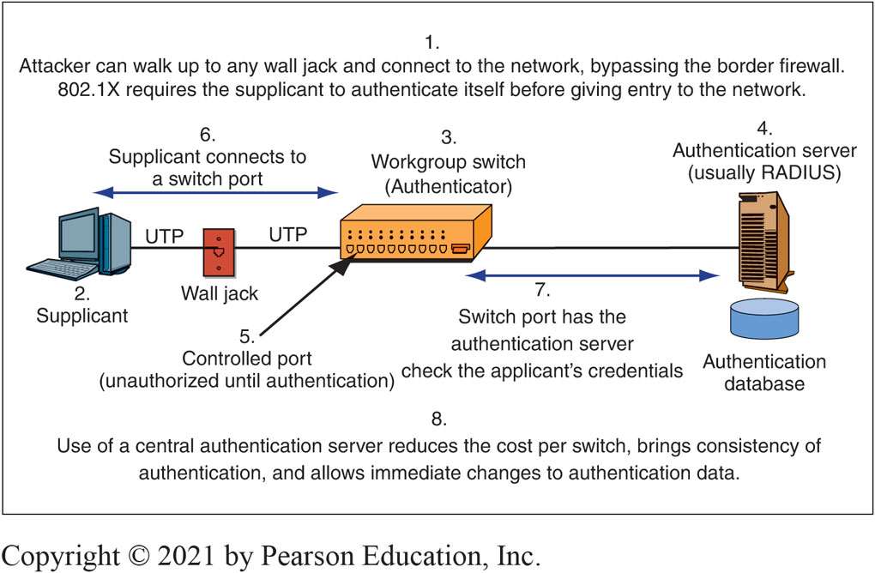
Ethernet Security
The 802.1X standard : Provides access control to prevent illegitimate clients from associating with a network
Advantages in using a central authentication server instead of having each workgroup switch do all the work:
Cost savings
Consistency
Immediate changes
Notes:
This figure illustrates the main elements of Ethernet and 802.1X security.

Slide 14
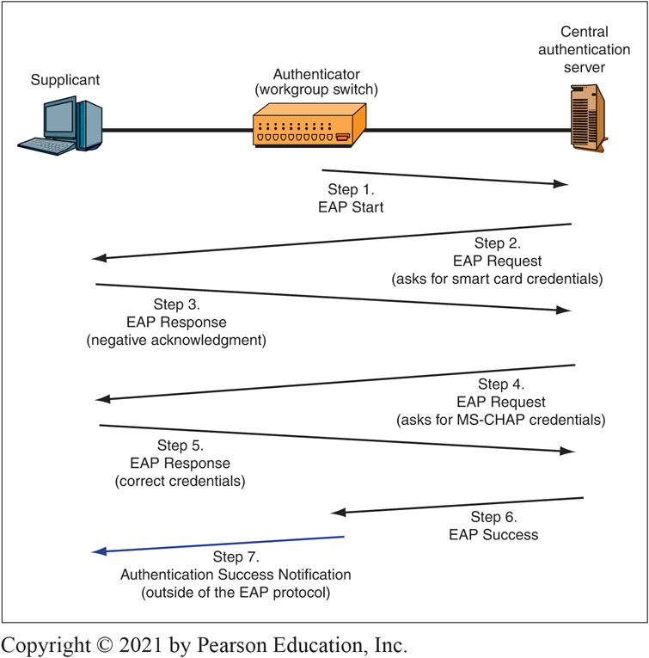
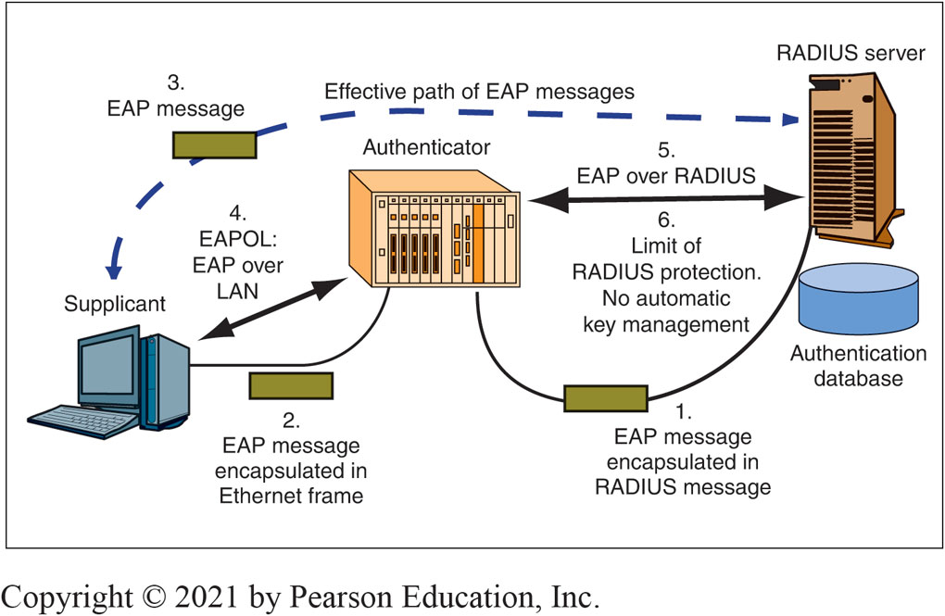
The Extensible Authentication Protocol (EAP)
Read: https://doubleoctopus.com/security-wiki/protocol/extensible-authentication-protocol/
Watch: https://www.youtube.com/watch?v=PHoLD91qE5A
Fig. 4.19 EAP
Fig.4.20 EAP over Radius
Notes:
Figure 4-19 shows that 802.1X relies on another protocol, the Extensible Authentication Protocol (EAP), to govern the specifics of authentication interactions. The figure shows a simple authentication dialogue using EAP.

Slide 15
Wireless Security
Open networks can be accessed by anyone
Found in public places like cafés, coffee shops, universities, etc.
Private networks do not allow access unless specifically authorized
Secured networks have security protocols enabled
Users are authenticated and wireless traffic is encrypted
Rogue access points
Unauthorized access points set up with little or no security
Packet sniffer (SolarWinds, tcpdump, WinDump, WireShark,,,): can be used to gather network information or user data
Radio frequency monitoring (RFMON): can pick up wireless packets addressed to other hosts
Promiscuous mode: Allows you to receive messages addressed to other users. Read https://www.techtarget.com/searchsecurity/definition/promiscuous-mode
SEE SOME ATTACKS ON THE NEXT SLIDES

Slide 16
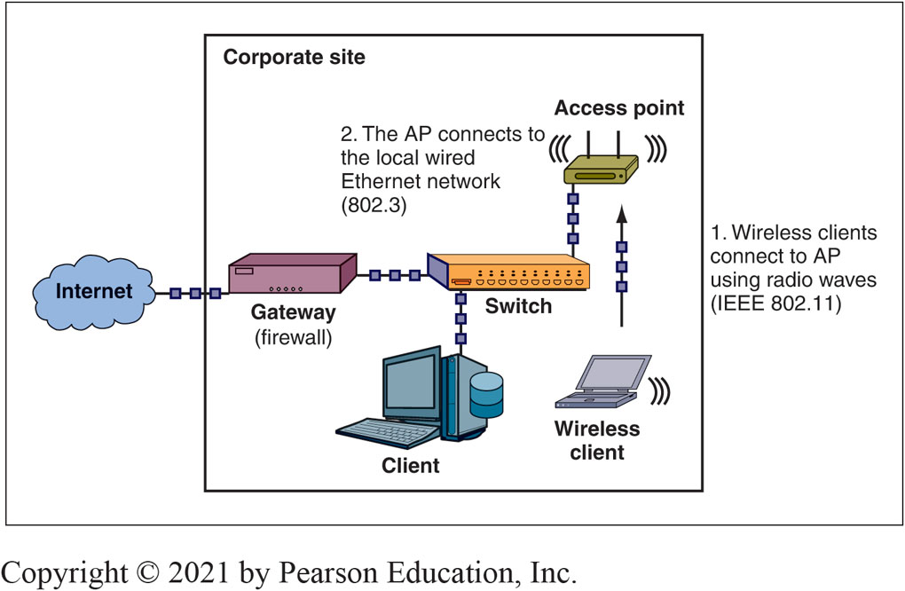
Fig.4-21: Wireless Network Access
Notes:
As shown in Figure 4-21, users connect via radio waves to a wireless access point (AP) using the 802.11 standards, developed by the IEEE 802.11 Working Group (1). The AP then connects to the local Ethernet (802.3) network with a wired connection (2). The AP acts as a relay point between the wireless and wired networks.

Slide 17
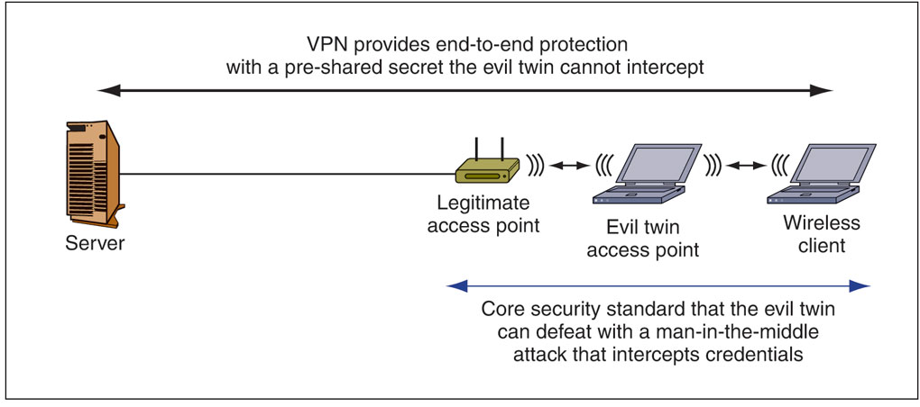
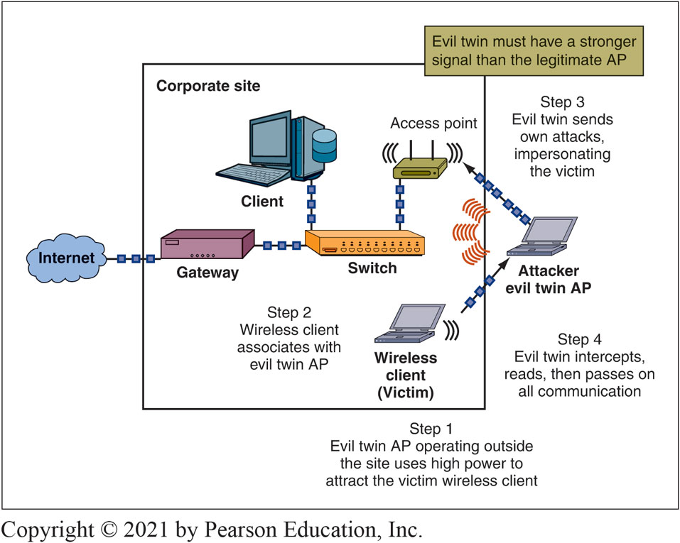
Fig.4-24 Evil twin outside the company’s premises
Fig.4-23 Man in the middle attack – evil twin (inside the company’s premises
Notes:
As this figure shows, an attacker sets up an evil twin access point outside the company’s premises.

Slide 18
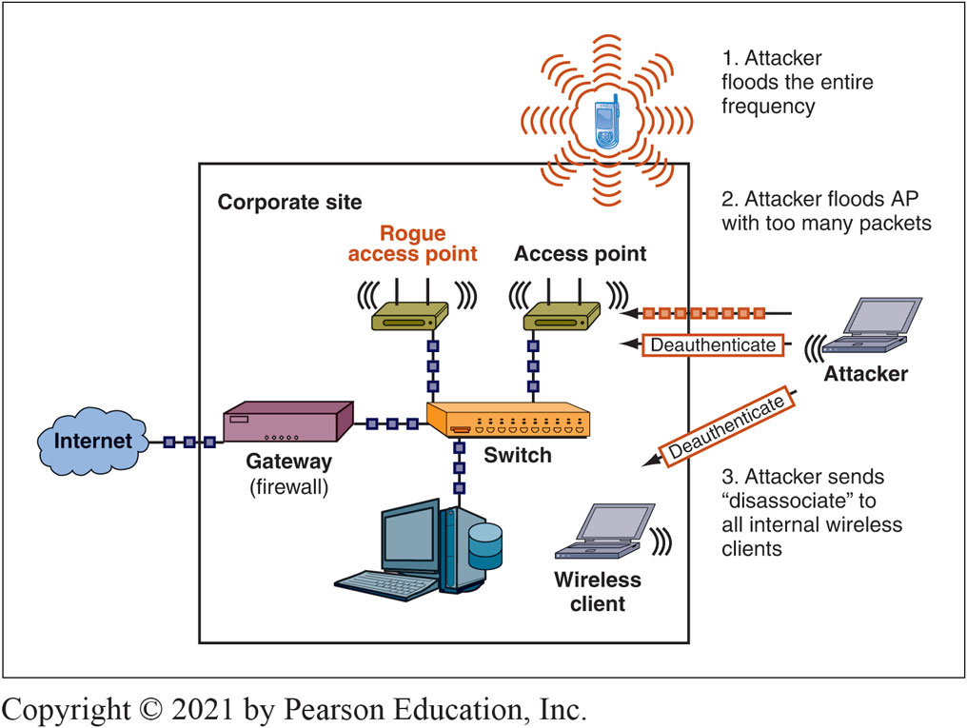
Fig. 4-25 Disassociation and Jamming
Notes:
Attackers can alter wireless devices to flood these frequency bands with electromagnetic interference (EMI), also known as radio frequency interference (RFI). The interference, or noise, damages the 802.11 signal and makes the packets unreadable.
This figure shows that attackers can use common household items such as baby monitors, cordless phones, and Bluetooth devices to interfere with an 802.11 network. There are commercial wireless jamming appliances that can flood not only 802.11 frequencies but cellular phone frequencies too.
Network administrators can use wireless spectrum analyzers to identify DoS floods. Spectrum analyzers record all signals, including packet transmissions, within a given radio frequency band.

Slide 19
Wireless Security protocols
WEP : Original core security standard 802.11, created in 1997. Uses a Shared Key for all encryption. Possession of key authenticates user….sharing is not secure ☹
Also, WEP uses RC4 – weak. ☹ if two frames encrypted with the same RC4 key are compared, the attacker can learn the key. To strengthen WEP uses a per-frame key, which is the shared WEP key plus an initialization vector (IV). However, with high traffic, an attacker using readily available software can crack a shared key in two or three minutes
Wi-Fi Protected Access (WPATM) - Standard created by the Wi-Fi Alliance
Extends the security of RC4 primarily by increasing the IV from 24 bits to 48 bits (harder to crack)
WPA2 (802.11i): New standard for purposes of interoperability testing
WPA3: Released by the Wi-Fi Alliance designed to address some of the weaknesses in WPA2
Watch : https://www.youtube.com/watch?v=jErjdGfbgoE

Slide 20
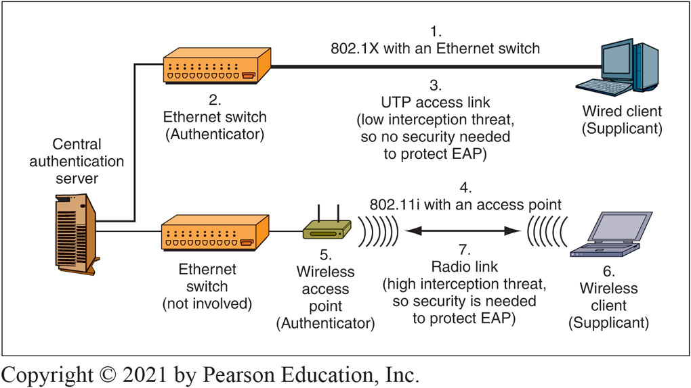
Figure 4-26: 802.11i or WPA Wireless LAN Access Control in 802.1X Mode
Notes:
In wireless LANs, EAP needs additional security. Figure 4-26 shows that radio transmissions can be intercepted. Thanks to the inherent lack of security in wireless transmission (7), there has to be added security between the wireless client and the access point, or EAP authentication can be easily attacked. To provide this security,
the 802.11 Working Group enhanced the 802.1X standard to work over wireless LANs.
This enhanced standard is 802.11i.

Slide 21
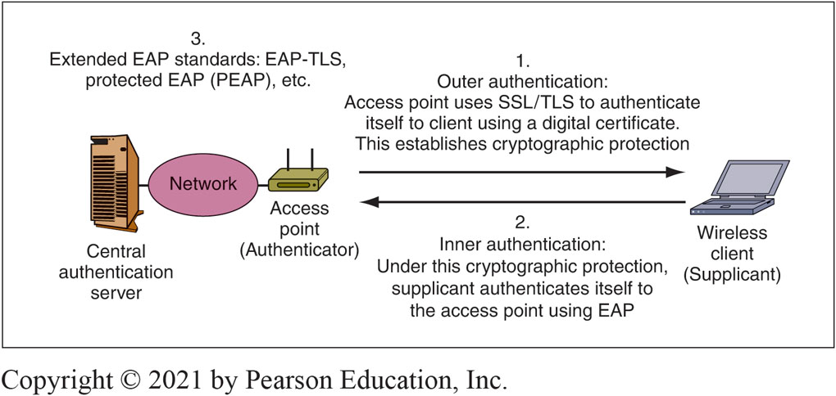
Figure 4-27: Extended EAP Protocols
Notes:
The enhancement comes through extending EAP standards to add security. All extended EAP standards begin the same way. As Figure 4-27 shows, the authenticator first establishes an SSL/TLS secure connection between the authenticator and the wireless client. In this outer authentication, the access point has a digital certificate that it uses to authenticate itself to the wireless client.

Slide 22
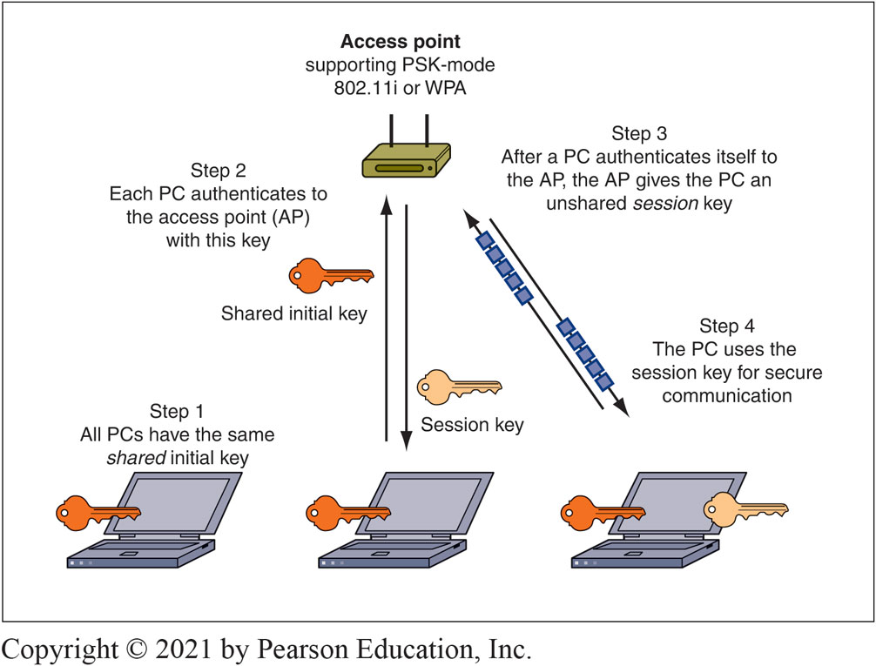
Pre-Shared Key (PSK)/Personal Mode for 802.11i and EAP
Notes:
WPA and 802.11i both offer a non-802.1X mode called pre-shared key (PSK) mode. WPA, which is based on an early draft of 802.11i, also includes this mode but calls it personal mode. Specifically, PSK/personal mode was created for homes or small businesses that only have a single access point.
Figure 4-31 shows that all wireless clients authenticate themselves to the access point using a shared initial key used by all clients.

Slide 23
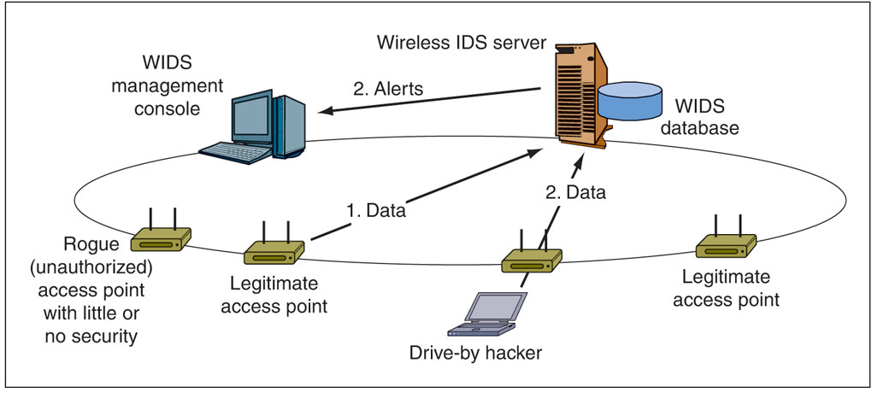
OTHER MEANS OF PRTOECTION : Centralized Wireless Intrusion Detection System
Notes:
Companies that have central management for their many access points can purchase centralized wireless intrusion detection system software. As this figure illustrates, each access point becomes a wireless IDS agent, sending appropriate information to the central wireless IDS console. The console transfers the data to an IDS database. It also sorts through data in the database to find indications of problems.

Slide 24
SSID?
Service set identifier, or SSID is an identifier for an access point
Users must know the SSID to use the access point ← → Drive-by hacker needs to know the SSID to break in
Turning off SSID broadcasting ? ← → Can make access more difficult for ordinary users
AND
will not deter the attacker because the SSID, is transmitted in the clear in each transmitted frame ☹

Slide 25
Enter AI
Dewangan, O., & Sarkar, P. (2022). A Study on Network Security Using Deep Learning Methods. Advanced Engineering Science, 54(02).
Yu, J., Ye, X., & Li, H. (2022). A high precision intrusion detection system for network security communication based on multi-scale convolutional neural network. Future Generation Computer Systems, 129, 399-406.

